Slide 1

Using time-series features to solve time-series classification problems
Trent Henderson | 30 September 2022
Slides are available here!

Slide 2
An imaginative exercise

Slide 3

What you are faced with
Time-series classification
5 classes
N = 100
Neuroscience
T = 4097
Henderson, T., & Fulcher, B. D. (2022). Feature-Based Time-Series Analysis in R using the theft Package. arXiv: 2208.06146

Slide 4


Slide 5


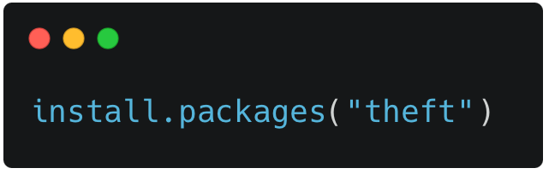
theft
Tools for Handling Extraction of Features from Time series
The time series software package for R you never knew you needed
theft is a unified and extendable R framework for computing features from six open-source feature sets.
It also includes a suite of functions for processing and interpreting the performance of extracted features, with extensive data-visualisation templates, low-dimensional projections, and fitting and evaluation of feature-based classifiers.

Slide 6
theft extracts features from six libraries in one convenient package
catch22
Kats
R, 22 features
Python, 40 features
feasts
TSFEL
R, 42 features
Python, 390 features
tsfeatures
tsfresh
R, 63 features
Python, 779 features

Slide 7
And provides an extensive workflow for feature-based time-series analysis

Slide 8
The answers soon start to come…
Henderson, T., & Fulcher, B. D. (2022). Feature-Based Time-Series Analysis in R using the theft Package. arXiv: 2208.06146

Slide 9
The answers soon start to come…
Henderson, T., & Fulcher, B. D. (2022). Feature-Based Time-Series Analysis in R using the theft Package. arXiv: 2208.06146

Slide 10
More scientific findings were uncovered
Permutation testing on a binary subset revealed statistical differences between the sets
These findings are powerful for a single dataset
But we are interested in all types of data and problems
We want to understand in general when feature sets do well
1
Analysis of top features revealed two broad clusters: “autocorrelation” and “variance”
2
Visualisation of distributions for top features highlighted class differences
3

Slide 11

Sets differ in redundancy and speed
catch22 requires 50% of PCs to explain 90% of the variance, while tsfresh only needs ~7% and TSFEL ~1%
Feature sets vary over order of magnitudes in computation time per feature
Henderson, T., & Fulcher, B. D. (2021). An Empirical Evaluation of Time-Series Feature Sets. 2021 International Conference on Data Mining Workshops, 1032-1038

Slide 12

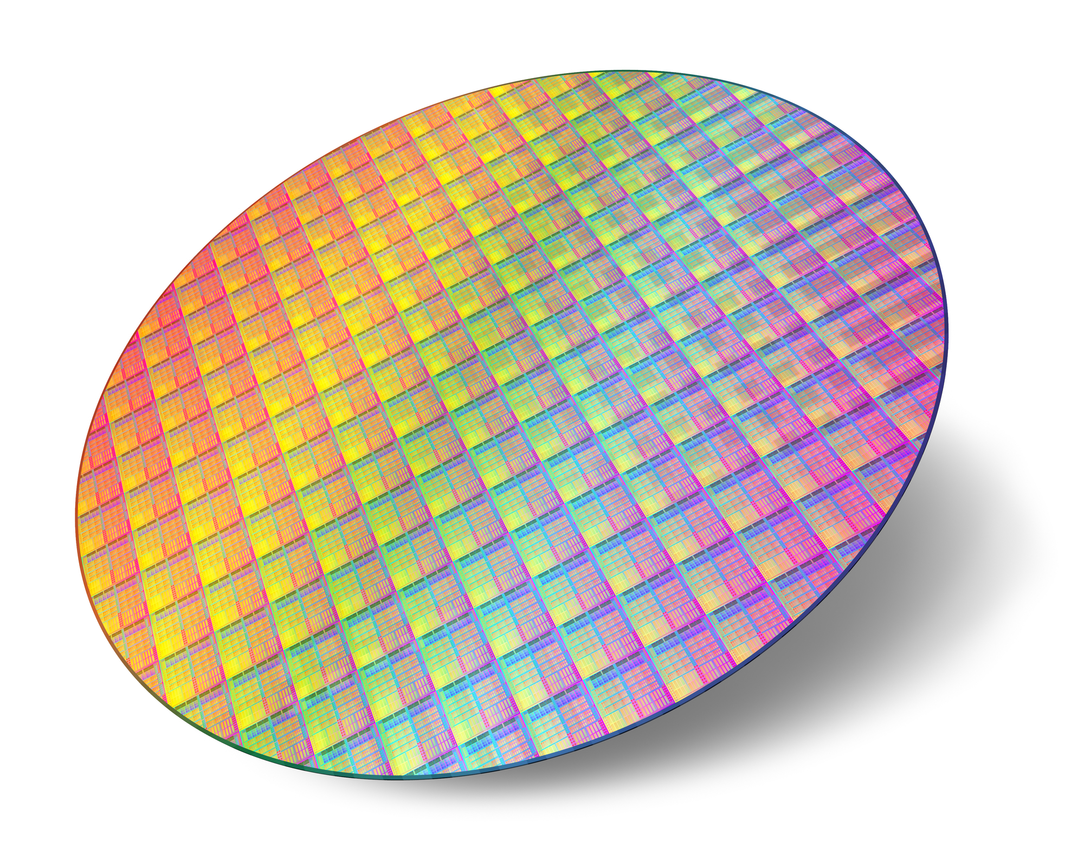
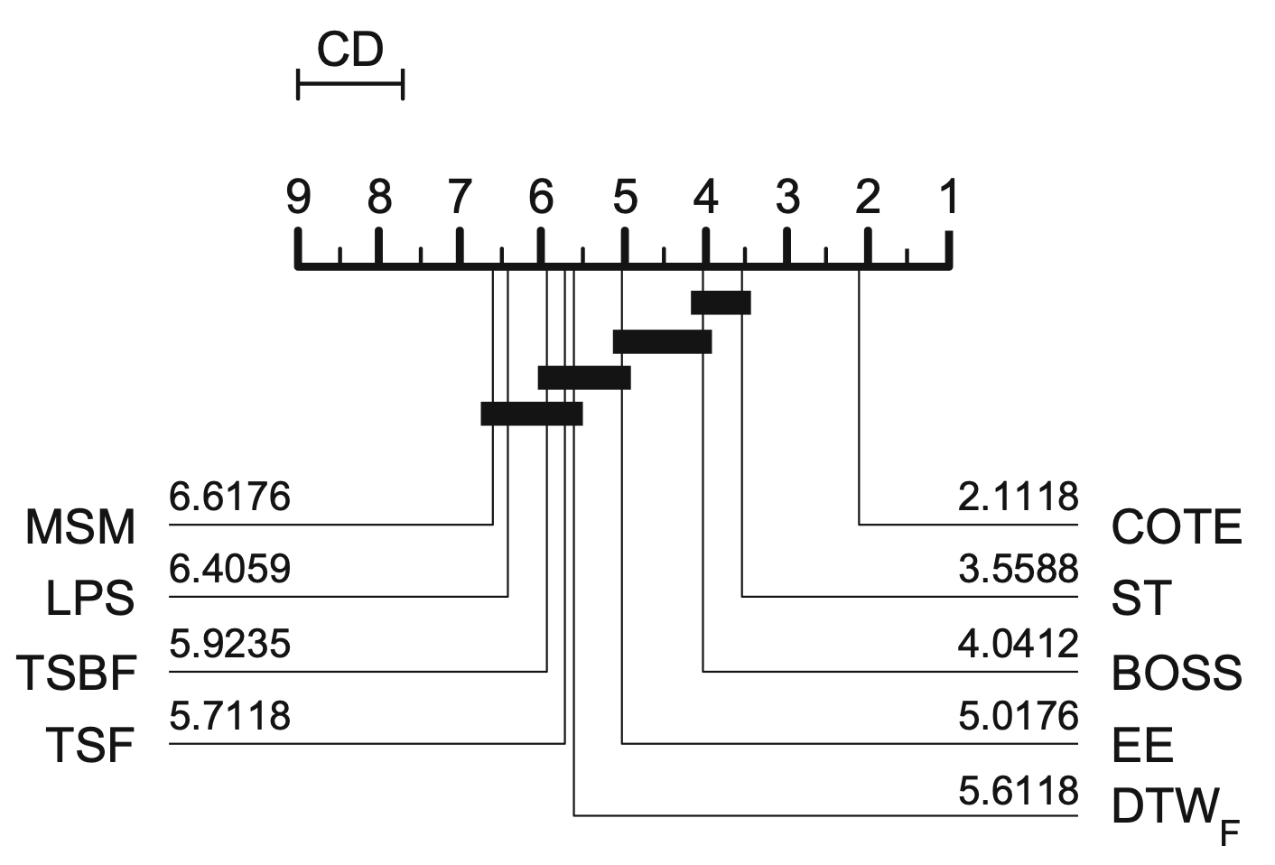
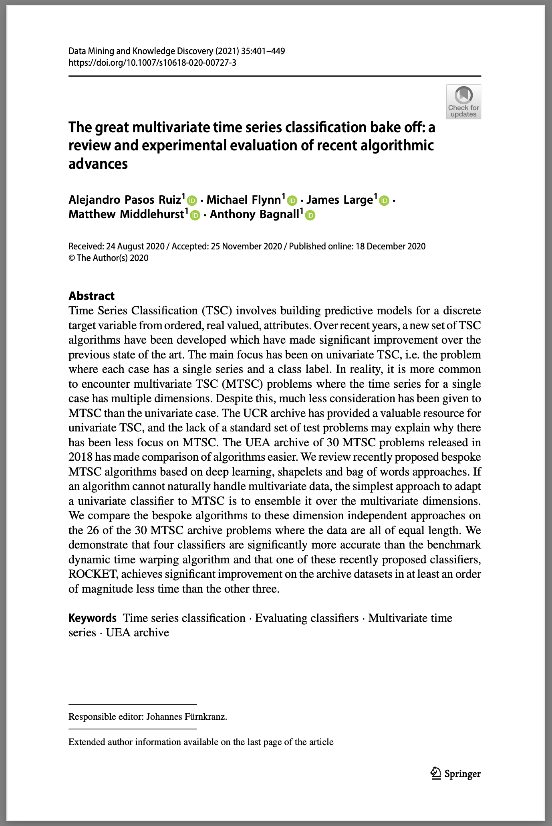
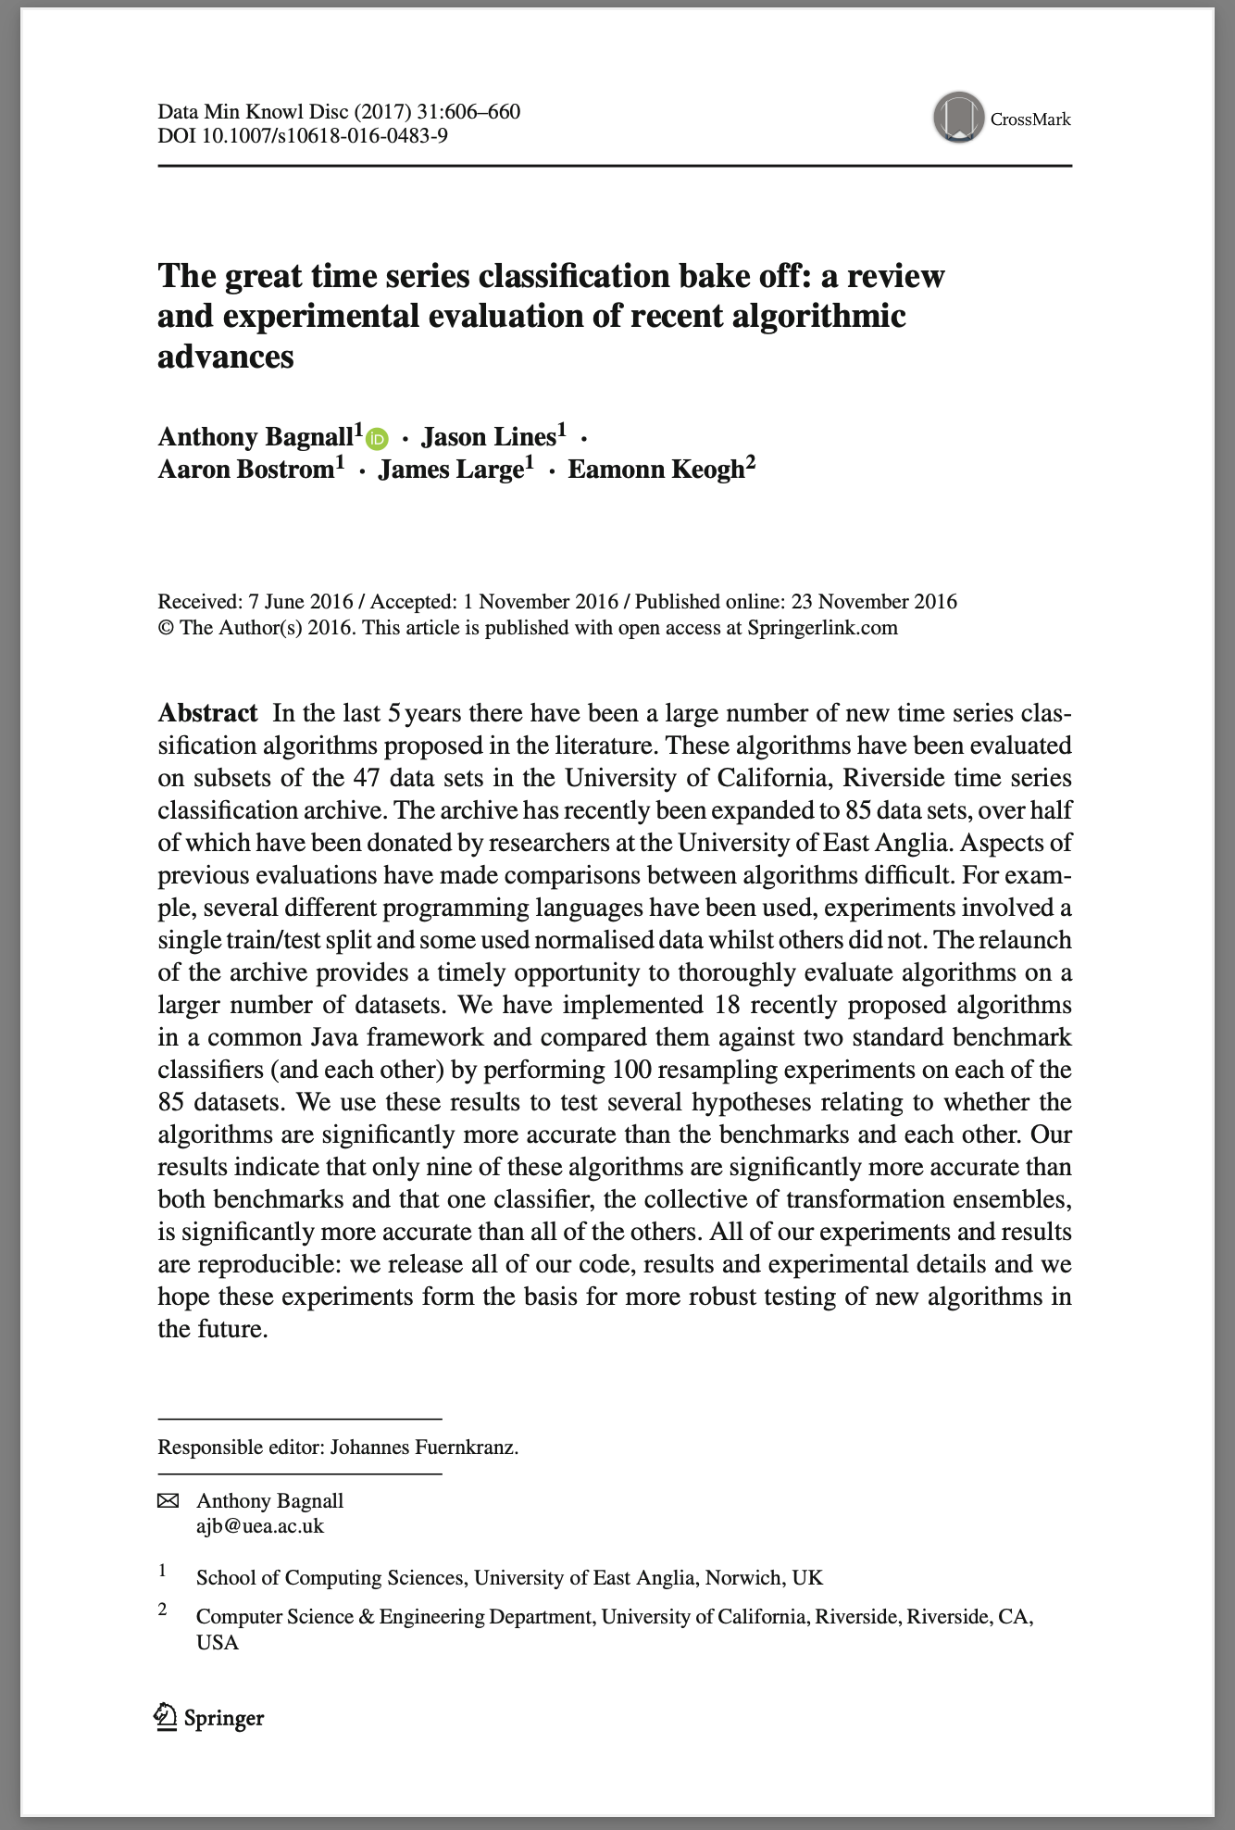
We systematically evaluated performance on 128 problems
The UEA/UCR repository contains 128 univariate time-series classification datasets
Aim 1: Improve benchmarking methods for time-series classification algorithms
Aim 2: Understand in a more nuanced way the strengths/weaknesses of each set on different problems

Slide 13
We innovated a new method for benchmarking time-series classifiers
Current benchmarking typically computes ranks from mean classification accuracy
This ignores subtleties in performance, where some ranks may be separated by large margins
We implemented a novel normalised performance score which captures the relativities between each feature set’s accuracy

Slide 14




Thanks for listening!
Feel free to get in touch:
then6675@uni.sydney.edu.au
https://github.com/hendersontrent
@trentlikesstats
https://www.linkedin.com/in/trent-henderson/
Some of my software packages:

